Slide 1
Text Analysis
Introduction to Data Visualization
The Graduate Center at CUNY
Michelle A. McSweeney

Slide 2
Five Minute Reflection
Moretti presents us with a problem: “a canon of two hundred novels sounds very large for nineteenth-century Britain, but is still less than one per cent of the novels that were actually published: twenty thousand, thirty, more, no one really knows—and close reading won’t help here, a novel a day every day of the year would take a century” – Moretti, 2003, pg 1.

Slide 3
Texts as Data
Corpus/Corpora
Collection of documents
Tweets
Books
Zines
Text messages
Newspaper Articles
Supreme Court proceedings
Notes:
Words
Words near other words

Slide 4
Working with text
Given a document, what can you quantify?

Slide 5
Working with Documents
Can quantify:
Word/Part-of-Speech frequencies
Punctuation frequencies
Units (sentences/paragraphs/chapters/etc.)
N-grams (bigrams/trigrams/etc.)
Word offsets
Topic Modelling
Sentiment Analysis
Next-word predictions

Slide 6
Working with text
Given a document, what can you quantify?
Given a corpus, what can you quantify?

Slide 7
Working with Corpora
MetaData
Content
Date (Time)
Location
Creators (author, publisher, etc.)
Platform/Format
Sales/Retweet/Distribution
Length
Keywords
Title
Revision History
Word frequencies
N-grams
Word offset
Topic Modelling
Sentiment Analysis
Predictions

Slide 8
Metadata
http://criminalintent.org/
2011/06/criminal-intent-the-poster-2/

Slide 9
Visualizing Edits
Viégas, Wattenberg, Dave, 2004. Studying Cooperation and Conflict between Authors
with history flow Visualizations

Slide 10
Visualizing Text
Metadata
Content
Darwin’s Origin of the Species Edits https://fathom.info/traces/
Presidential Debates (n-grams) https://public.tableau.com/views/Election2016-SpeechAnalysis/Newspaper?:embed=y&:display_count=yes&:toolbar=no&:showVizHome=no
https://books.google.com/ngrams/

Slide 11
Metadata
Can usually be formatted for visualization with minimal cleaning
Categorical or Numerical
Tells a story about the text
Jørgen Stamp digitalbevaring.dk CC BY 2.5 Denmark

Slide 12
Working with Text
Some Cleaning
A Lot of Cleaning
Word Counts/Frequencies
Offsets
N-grams
Comparing two or more texts
Lexical Density/Diversity
N-grams
Topic Modelling
Sentiment Analysis
Predictions

Slide 13
Cleaning Text
DON’T DO THIS WITH TABLEAU
Tokenize (split into words)
Normalize (remove punctuation and capitalization)
Remove Stopwords (determiners, prepositions, auxiliaries, etc.)
Stem or Lemmatize (transform “run”, “runs”, and ”running” into “run”)

Slide 14
Frequency Distributions
Moby Dick (Herman Melville)
Sense and Sensibility (Jane Austen)

Slide 15
Cleaning Text

Slide 16
Cleaned Text Analysis
https://public.tableau.com/profile/rody.zakovich#!/vizhome/
AChristmasCarolTextAnalysis/AChistmasCarolTextAnalysis

Slide 17
Texts as visualizations: Sentiment Analysis
Sentiment analysis is a Natural Language
Processing technique using Machine Learning
It is a Classification Task (labels each instance)
to tag positive or negative usually based on a
previously tagged corpus (but not always)
https://www.biblegateway.com/blog/2011/10/
the-ups-and-downs-of-the-bible-a-sentiment-analysis-of-scripture/

Slide 18
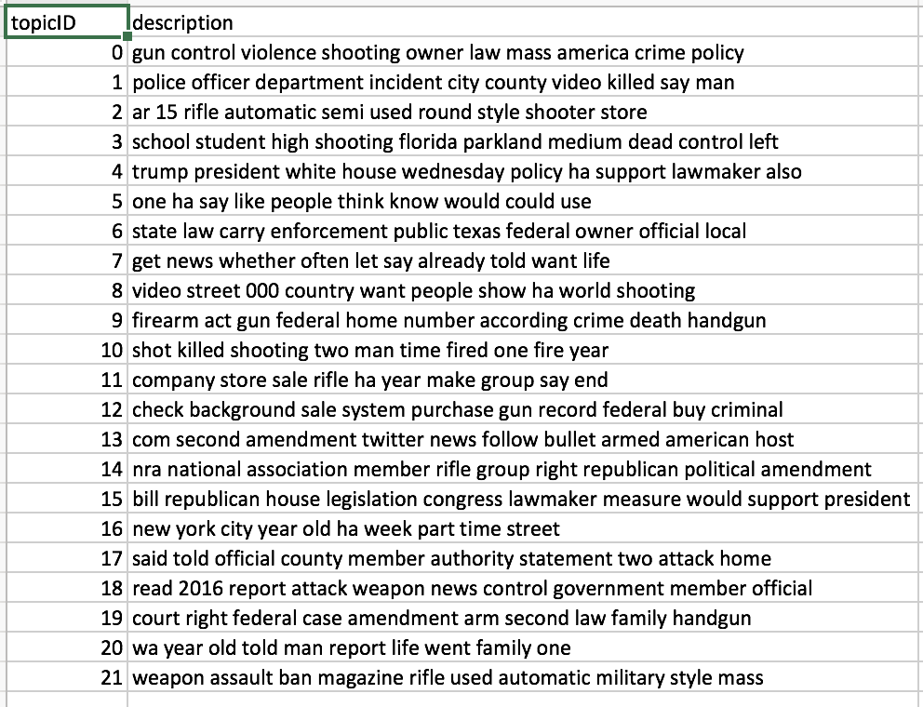
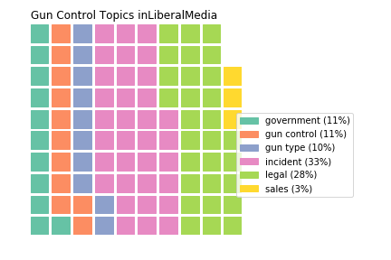
Texts as visualizations: Topic Modelling
Topic Modelling is a Natural Language
Processing technique using Machine Learning

Slide 19
Distant Reading
Understanding literature through data
Scientific Method
Hypothesis
Experiment
Analysis
Topic Modelling / Sentiment Analysis
Named Entity Recognition/ Relation Detection

Slide 20
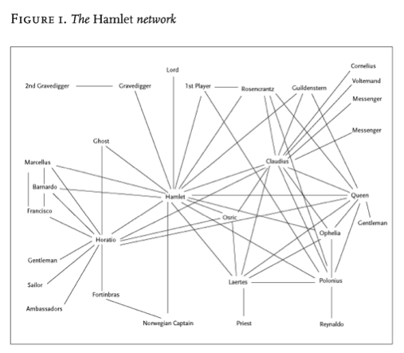
Moretti

