Slide 1
Data
Introduction to Data Visualization
The Graduate Center at CUNY
Michelle A. McSweeney

Slide 2
Forum
Sort the following people into no more than 3 categories (feel free to google them):
Leo Tolstoy
Beyoncé Knowles
Nathan Yau
Haruki Murakami
Oprah Winfrey
Victor Hugo
Miriam Makeba
Michael Jackson
J.K. Rowling
Lev Manovich
William Playfair
Notes:
What were your categories? Why?
”War and Peace” by Leo Tolstoy
“Formation” by Beyoncé Knowles
Michael Jackson
“Data Points” by Nathan Yau
“The Flight of the Bumblebee” by Nikolai Rimsky-Korsakov
“Norwegian Wood” by Haruki Murakami
Anna Pavlova
“Pata Pata” by Miriam Makeba
How did each of you do it? Was there anyone who didn’t fit? What did you do with them?

Slide 3
Grouping Types
Notational
Based on definitions
Ambiguous Classifications
Group membership can be argued
Qualitative and subjective
Famous People
Famous for
Role in society
Logical
Mathematically based
Covers all logical possibilities
Famous People
Number of letters
Year born/died
Alphabetical (syllables, etc.)
Number of children/pets/income

Slide 4
Data: plural of datum.
Notes:
Similar to the way Playfair is credited with inventing bar, line, and pie charts, Joseph Priestly is credited with inventing the concept of “data” around the 1770s. At the time, data was a revolutionary idea as the aggregation of data encoded a transformation of each datum.
Keeping this transformation at the front of our minds, in what ways (if at all) do you see data as distinct from an individual datum?

Slide 5
Data/Datum: something given in an argument; the starting point on which to build; that which is assumed
- Rosenberg 2013, Miriam Webster
Notes:
The definition itself is not about a representation of reality, but a starting place on which to build

Slide 6
Raw Data: ??
Notes:
Disaggregated data, generally in the aggregation state it was originally distributed in.

Slide 7
Making Data
Collection
Aggregation
Distribution
Interpretation

Slide 8
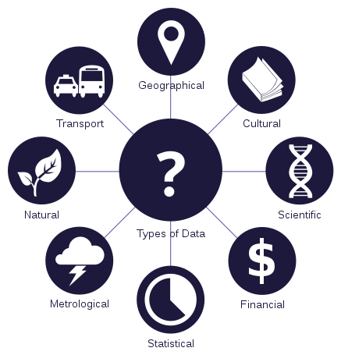
Collection
Surveys
Observations
Measurements
João Batista Neto
https://commons.wikimedia.org/w/index.php?curid=43063497

Slide 9
Aggregation
Disaggregated Instances
Counts
Mean/Median/Mode
Min/Max/Range
Quartiles
Datum
Datum
Datum
Summary

Slide 10

Distribution
Tables (csv/tsv/xls)
Text (txt/json)
Databases (SQL/Odata)
Shape File (shp/kmz)

Slide 11

Interpretation
Reviewing the results
Statistical/Analytical
“Insights”
Cultural context
Prior knowledge or research

Slide 12
Data Features (in Tableau)
Items: Each instance with all of its attributes
Attributes: The features of each item
Semantics: Real world meaning
Type: structural or mathematical interpretation
Notes:
What you have
What you know about what you have
What those points refer to in the world
How those points can be manipulated

Slide 13
AT001 | AT002 | AT003 | AT004 | AT005 | AT006 | AT007 | AT008
Leo Tolstoy | 0 | M | Russian | Author | Yes | 1828 | 20,000
Beyoncé Knowles | 1 | F | American | Musician | No | 1981 | 2,500,000
Nathan Yau | 1 | M | American | Statistician | Yes | NULL | 150,000
Haruki Murakami | 1 | M | Japanese | Author | No | 1949 | 300,000
Oprah Winfrey | 1 | F | American | Entertainer | No | 1954 | 2,000,000
Victor Hugo | 0 | M | French | Author | No | 1802 | 50,000
Miriam Makeba | 0 | F | South African | Musician | No | 1932 | 100,000
Michael Jackson | 0 | M | American | Musician | No | 1958 | 3,000,000
J.K. Rowling | 1 | F | British | Author | No | 1965 | 10,000,000
Lev Manovich | 1 | M | Russian | Researcher | Yes | 1960 | 250,000
William Playfair | 0 | M | Scottish | Economist | Yes | 1759 | 30,000

Slide 14
Items (records, instances)
Attributes (variables, features)
Leo Tolstoy
Beyoncé Knowles
Nathan Yau
Haruki Murakami
Oprah Winfrey
Victor Hugo
Miriam Makeba
Michael Jackson
J.K. Rowling
Lev Manovich
William Playfair
Living
Gender
Nationality
Occupation
Status as Academic
Birth Year
Salary

Slide 15
Semantics
Types
ID | Referent
AT001 | Name
AT002 | Living
AT003 | Gender
AT004 | Nationality
AT005 | Occupation
AT006 | Academic
AT007 | Birth Year
AT008 | Salary
Referent | Data Type
Name | String
Living | Boolean
Gender | Binary Code
Nationality | String
Occupation | String
Academic | Binary Code
Birth Year | Ordinal Number
Salary | Decimal Number

Slide 16
Data is Never “Raw”
Attributes are never perfect
Always have bins
Always have breaks
Data is, by definition, cultural
  Zeros
  Measurement
Collection
Storage
Transmission

Slide 17
Longitude as a Cultural Phenomenon
Latitude is easy to measure – there’s the equator for a zero point
Longitude has no known zero point
The only truth of longitude is that the Earth is spinning, so measuring time tells us something about distance.
Meridian lines were proposed as early as AD 200 by Ancient Greeks.
A culturally adopted was established by a clockmaker in Greenwich, England in 1851. It caught on and was adopted widely, but “zero” could just as easily have been set in New York, Mumbai, or Dakar
Longitude is a cultural measurement

Slide 18
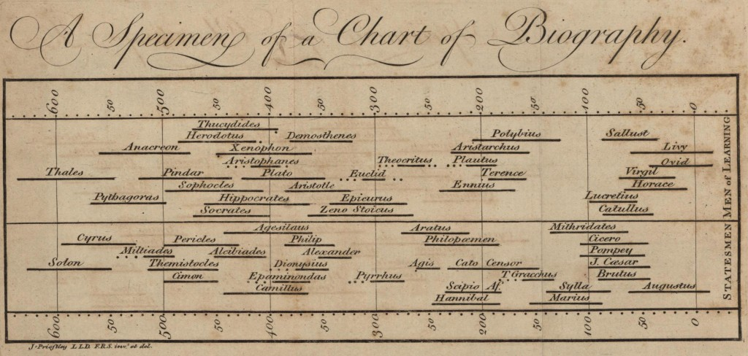
Notes:
Priestly’s 1765 Chart of Biography – over 2,000 names, this was used as the beginning for many arguments about historical relationships in Priestly’s Lectures on History and General Policy.
In this sense, it is what is taken as fact before the argument.
Who is included – according to Priestly, it’s everyone who was significant (about 2000 individuals in sports, arts, military, law, science, etc.) But even here, decisions were make

Slide 19
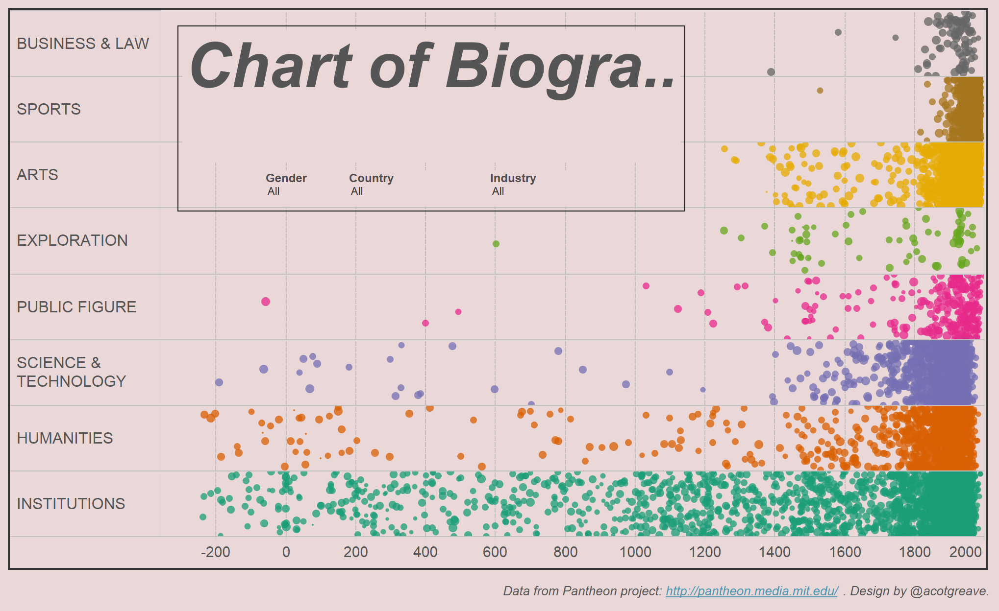
Priestly’s Chart Remade
https://public.tableau.com/views/Priestley/
ChartofBiography?:embed=y&:display_count
=yes&:showTabs=y&:showVizHome=no
Notes:
https://public.tableau.com/views/Priestley/ChartofBiography?:embed=y&:display_count=yes&:showTabs=y&:showVizHome=no

Slide 20
Data Types – Chart of Biography
Chart of Biography:
  Items: people
  Attributes: Name (nominal), area of influence (nominal), era (continuous)
  Timeline/ Gantt Chart
  Position, length, linear scale
Remake
  Items: people
  Attributes: Name (nominal), area of influence (nominal), era (continuous)
  Timeline/ Scatter Plot /Bar Chart?
  Position, Color, linear scale

Slide 21
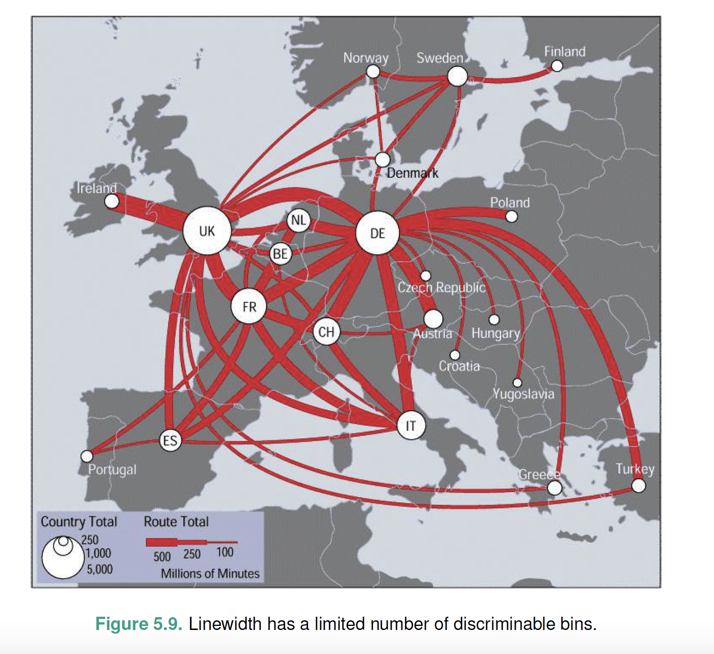
Bins & Breaks
How many can be perceived
How many can be understood
Here:
  3 sizes
  3 widths
Munzer 2015
Notes:
Once you have your data, have to break it up into bins and breaks

Slide 22
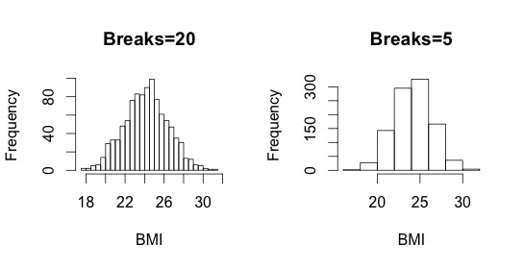
Bins & Breaks

Slide 23
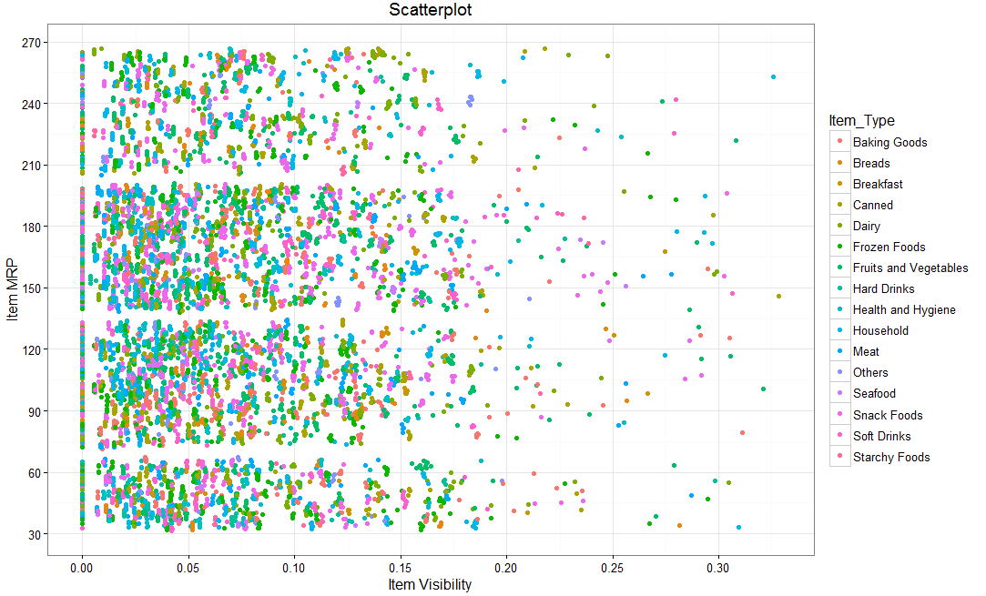
Bins & Breaks
Notes:
16 bins with color

Slide 24
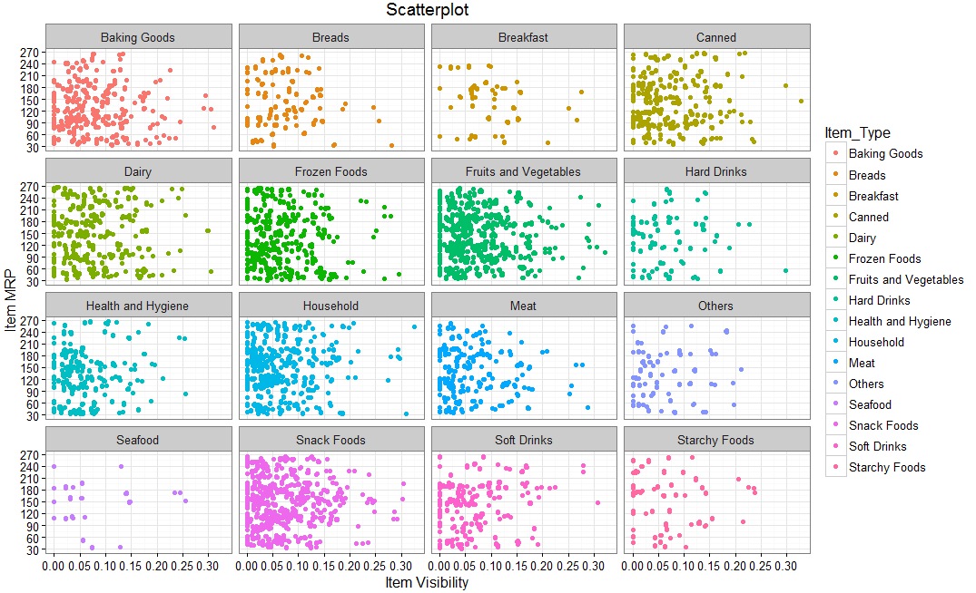
Bins & Breaks: Small Multiples

