Slide 1
Project 2: Data Creation
Create a dataset
Personal
Environmental
Social
Hand-curated
Downloaded
Etc
Visualize that data with as many visuals as you need
Proposal due Oct 25
Pin Up Nov 2

Slide 2
Quantified Self
Introduction to Data Visualization
The Graduate Center at CUNY Michelle A. McSweeney

Slide 3
Forum Reflection
The ‘Quantified Self’ movement seeks to incorporate technology and data into self-knowledge. From keeping track of food to steps to biomarkers, much of this data collection is in the service of self-knowledge or self-improvement.
One can argue that the desire to do so emerges naturally from an evidence-based, research-driven culture. But it is not without its problems. What dangers, if any, do you see in the “Quantified Self”.

Slide 4
Quantified Self Movement

Slide 5
What is Quantified Self?
Rise of health tracking apps/devices/etc.
Standards to measure oneself against
Quantification of biological markers

Slide 6
Mythology of Health Markers
10,000 steps a day = healthy
Manpo-Kei
Japanese for 10,000 step meter
Marketing ploy for Tokyo Olympics
8 Glasses of Water
Taken out of context-can get much of this water from food
Nutrition book Dr. Fredrick Stare (among other sources)
BMI is bad statistics by a mathematician – not a doctor
2,000 calories is an average
Etc.

Slide 7
Problems with the QS movement
Where does the data go?
Who is using the data and for what purposes?
Who is excluded?

Slide 8
Concerns about the QS Movement
Datafication of the Self
Quantification of the self
Constructs ‘health’ as a project of self-governance and self-surveillance, ignoring the social and structural factors that affect health, and how standards are established
Race
Income
Gender

Slide 9
Quantification of a Qualitative Life
Self-observation without governance
Data as observation (without a standard)

Slide 10
But how to represent Qualitative data?

Slide 11
Mona Chalabi
https://www.nytimes.com/interactive/2020/06/11/multimedia/coronavirus-new-york-inequality.html

Slide 12
The Pudding
https://pudding.cool/2020/09/wedding-playlists/

Slide 13
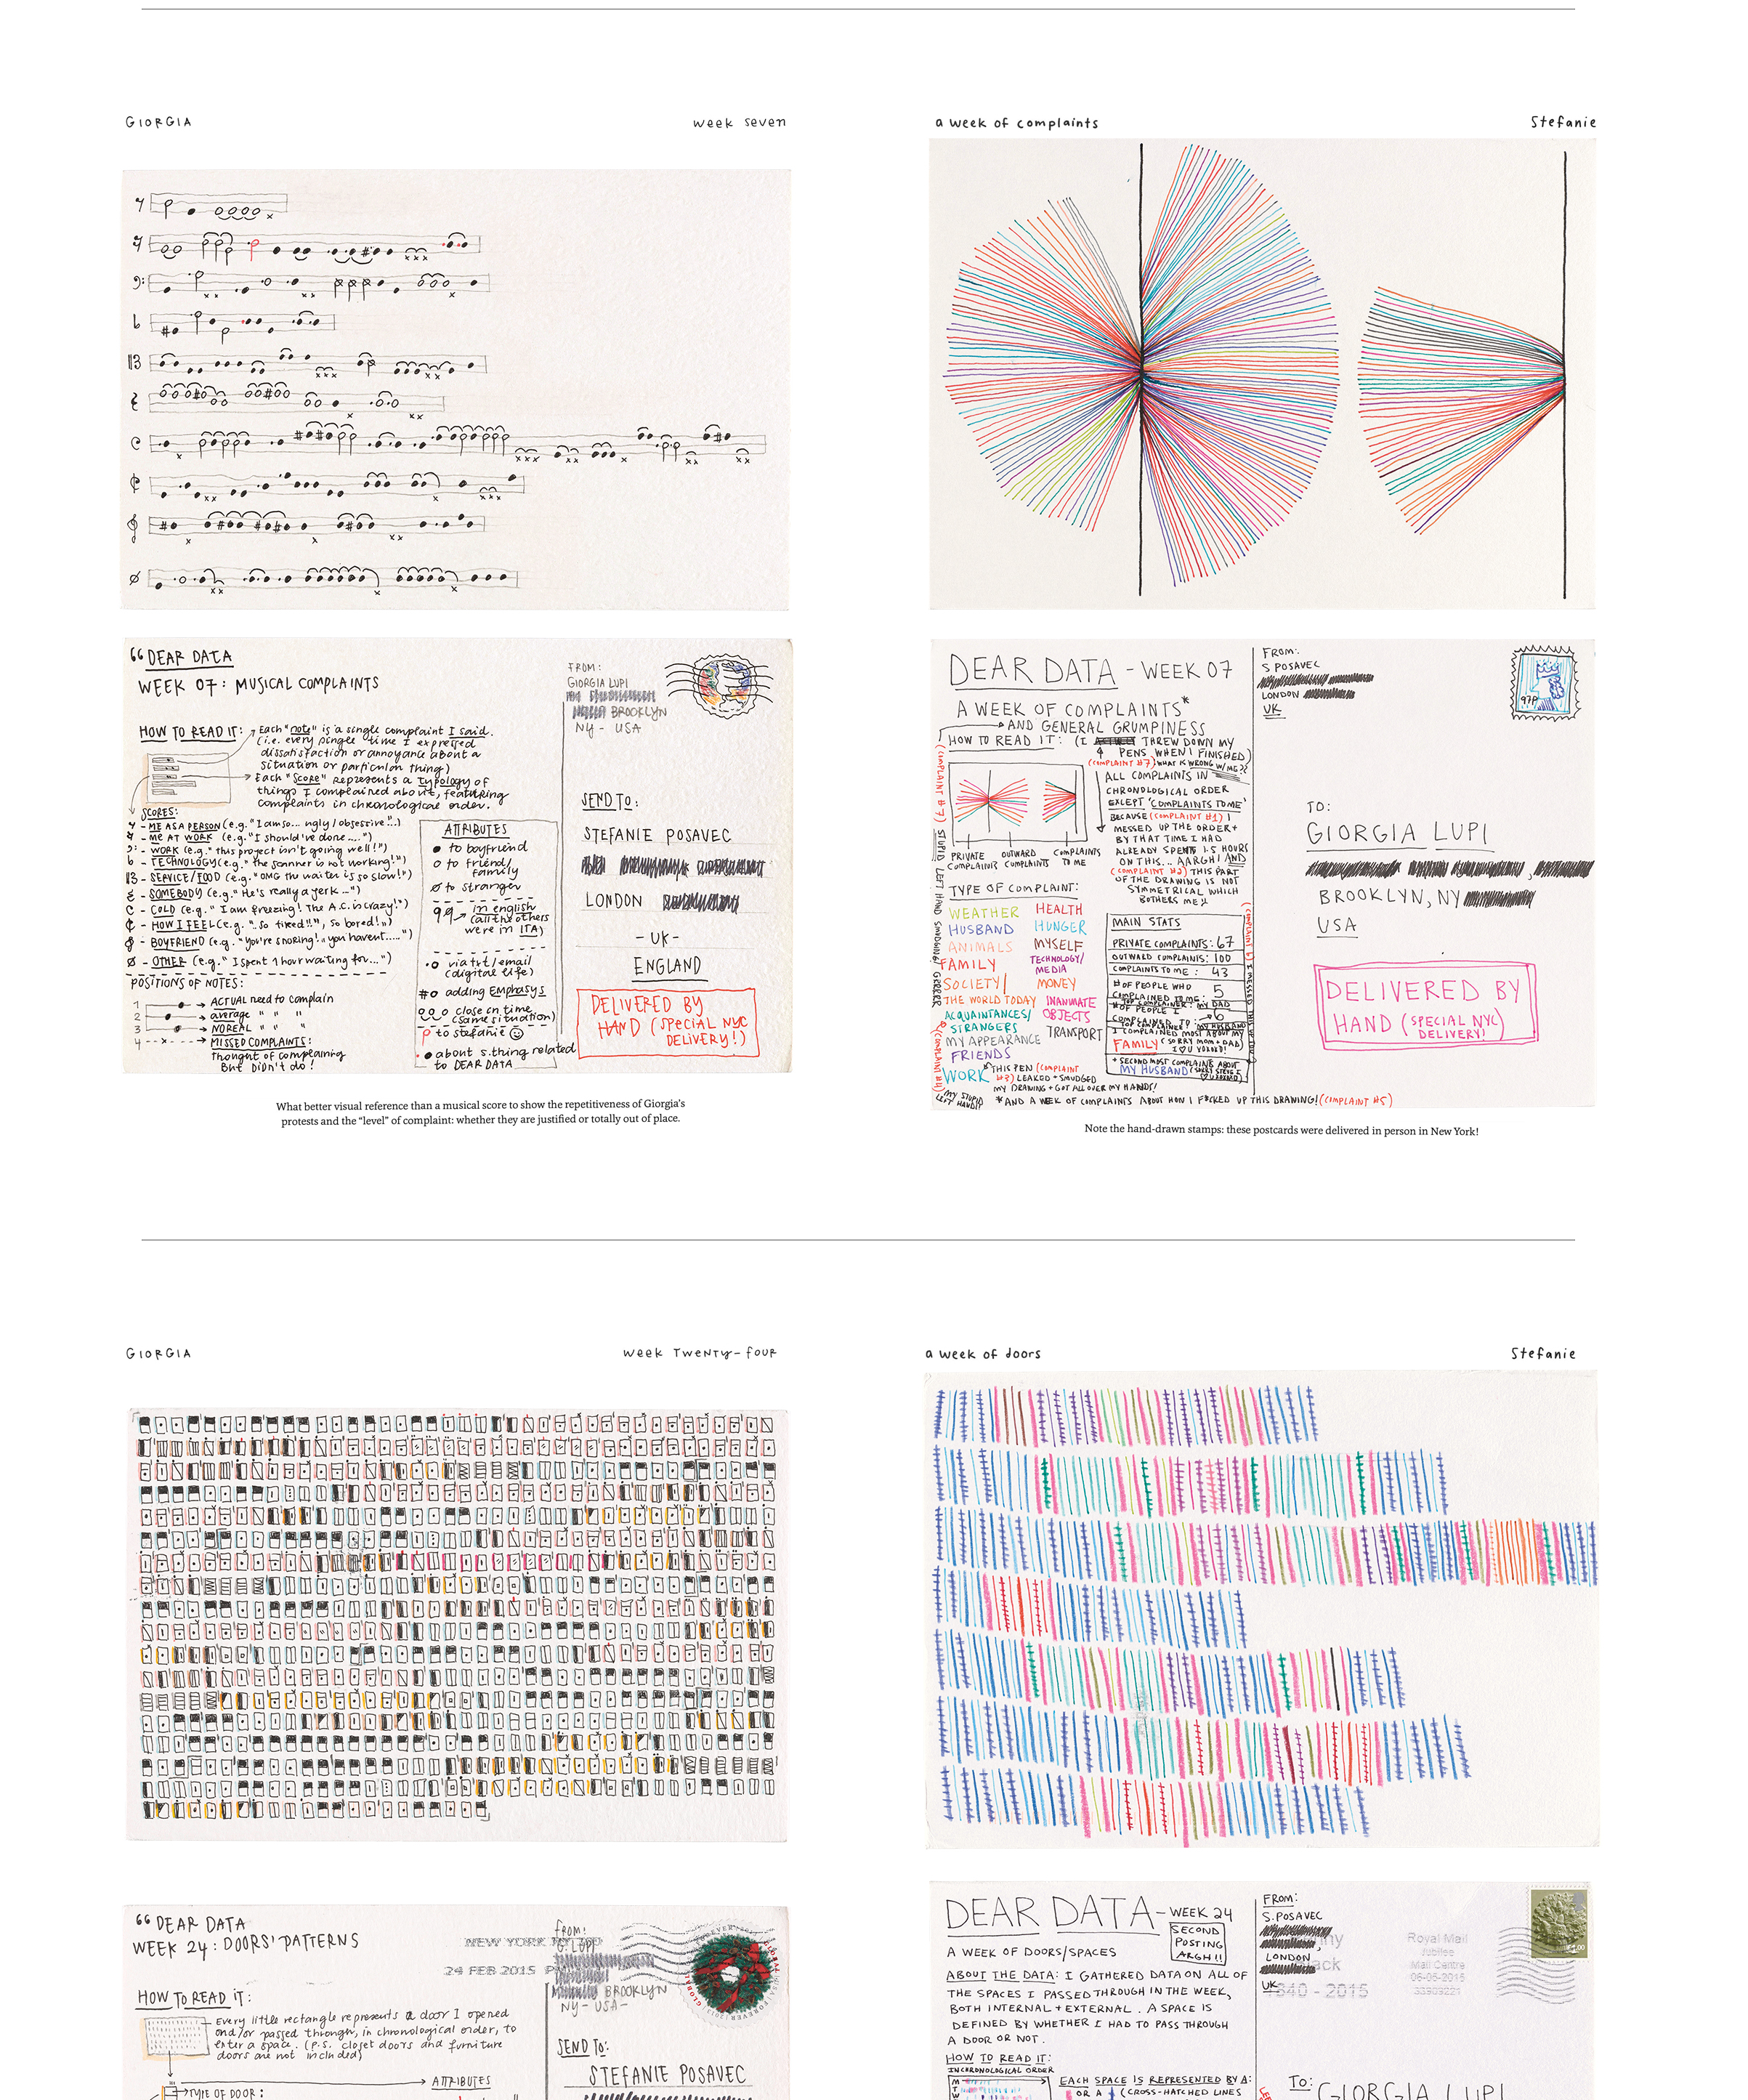
Dear Data 1 & 2

Slide 14
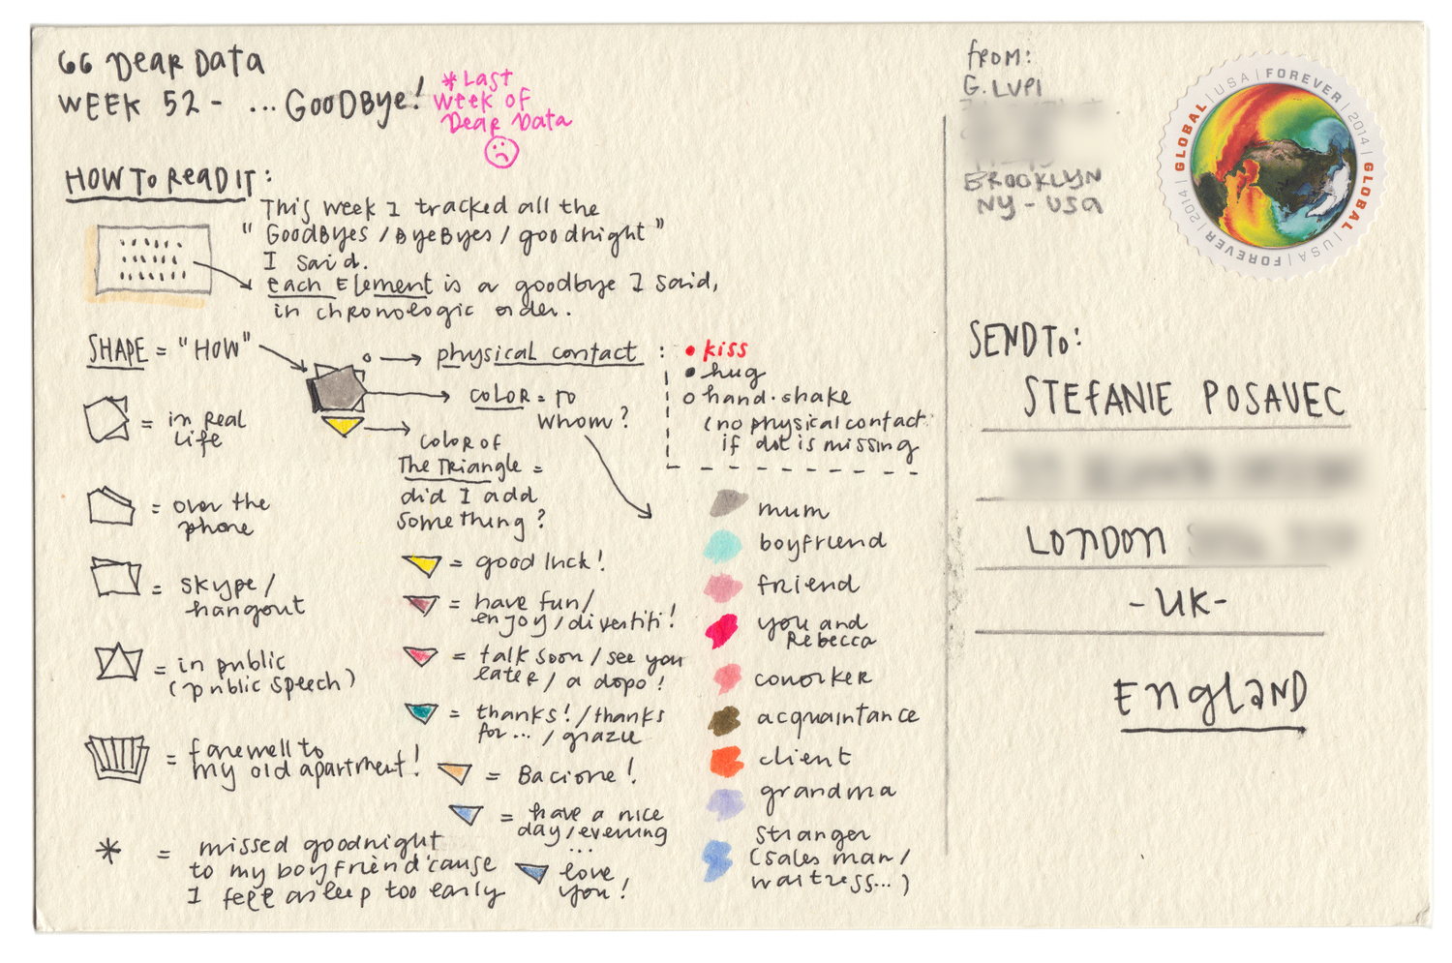
“Goodbye Dear Data”
http://www.dear-data.com/all/
Notes:
What technologies do you spot here?
Inspired by technology – and conceptually advance (color, shape, position), but the technology is colored pencils, writing, the post office the key, data visualization, not a computer

Slide 15
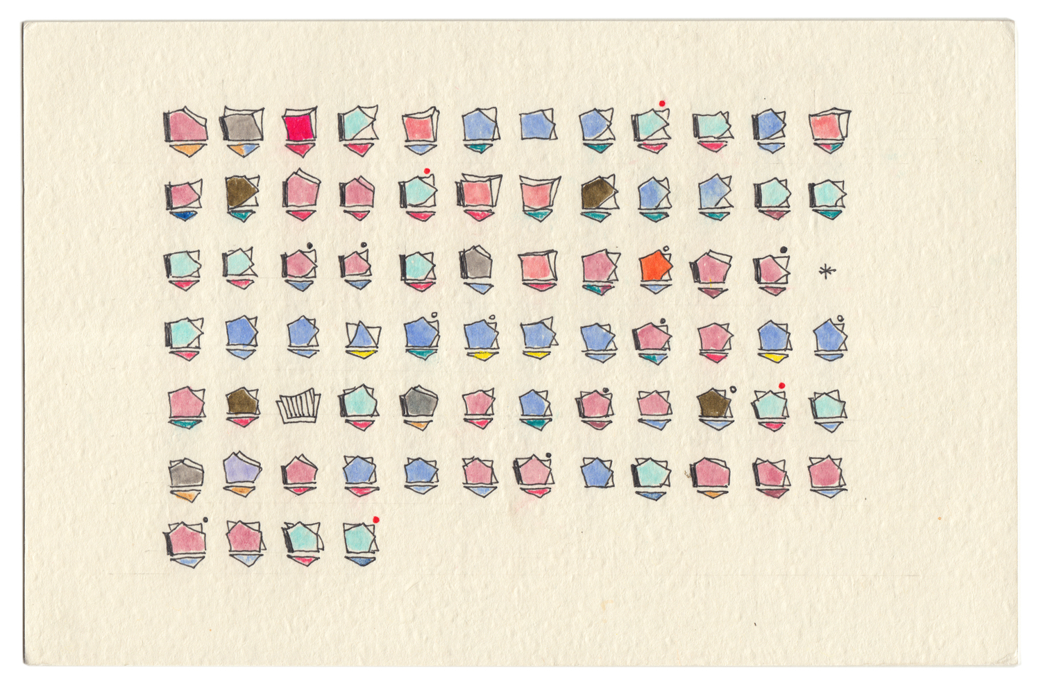
What is that visual?
Position
Time
Color
To whom
Shape
How

Slide 16
I don’t know how to read that!

Slide 18
Learn the Standards then Move Beyond
Notes:
Sketches and design are ESSENTIAL

Slide 19
Provide a Roadmap

Slide 20
Data will always be imperfect

Slide 21
CONTEXT
Know the Data
Collect it yourself if possible
Understand how it was collected
Really get to know the data
Transform it
Clean it
Sample from it

